Slide 1

Temporal User Embeddings for Mood Prediction
Matthew Matero | Akash Idnani | Radhika Gaonkar
Department of Computer Science
Stony Brook University
User embeddings have been shown to be helpful in tasks where author context is relevant
Task - use these embeddings to improve user mood prediction
Mood obtained by the affect score, where this score is a proxy to a user’s sentiments or emotions
User embeddings taken over time capture unique factors of change in a person’s language
Changes in user’s personality and therefore, her/his sentiments over time, can help in many user-centric NLP tasks:
Mood prediction, Addiction, Personalized Recommender Systems

Slide 2
Data
Weekly twitter data gathered from ~2,000 users over a span of 20 weeks
Labeled with Affect score
Train : 15 weeks, Test : 5 weeks for all users
Preprocessing : stopword removal, @ mentions, URLs and non-english characters
To enhance the uniqueness of each user embedding, further removal of the top 5% words from corpus
User Tweet | Intensity Value | Affect Value
Had the best day geochaching | 3.495457 | 5.717990
Enjoying boca grande :) http://twitpic.com/1yi7hb | 3.066374 | 5.656499
Going round the Holocaust Exhibition *shudder* | 3.122231 | 5.160040

Slide 3
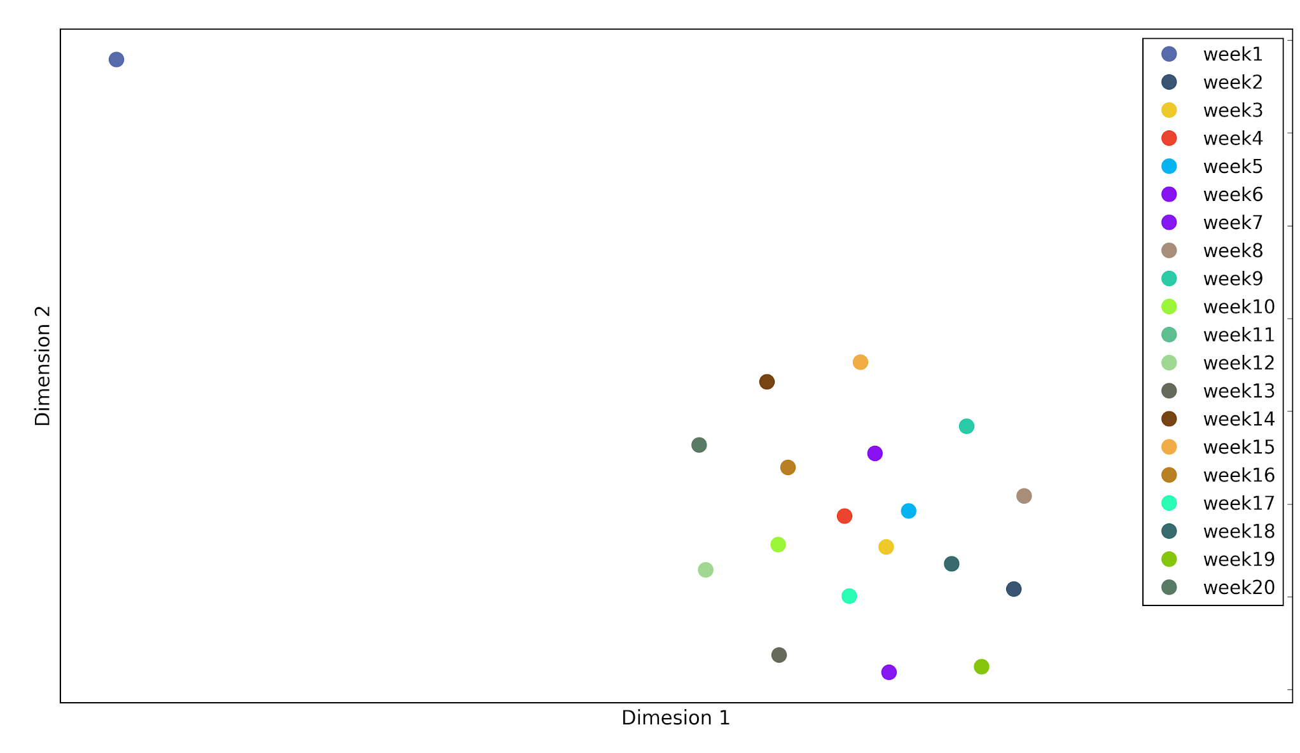
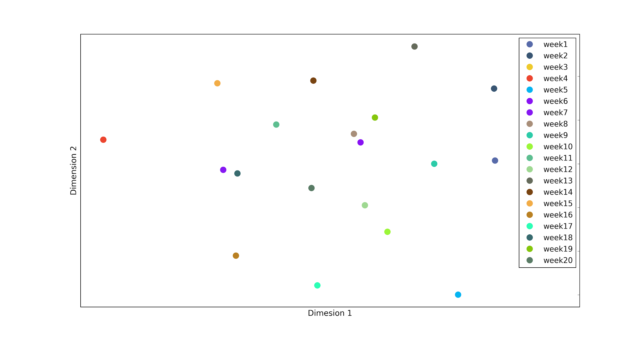
User Embeddings
Capturing change in user tweets over weeks
For each user matrix:
Size - weeks x vocabulary
Term Frequency Matrix
Temporal info captured in boolean difference matrix:
1 : new word appeared
-1 : word disappeared
0 : no change in word use
SVD on boolean matrix
User 1:
Week 1: i just had popcorn flavoured jellybeans! wow...what mind trip
Week 3: Sadly nobody will ever understand my very personal plight', 'When will this life end? Soon pls...soon
User 2:
Week 6:Bus has coffee all over the floor
Week 18: Biggest problem when drinking coffee when you have a big moustache?\coffee-flavoured moustache.'
User 1
User 2

Slide 4
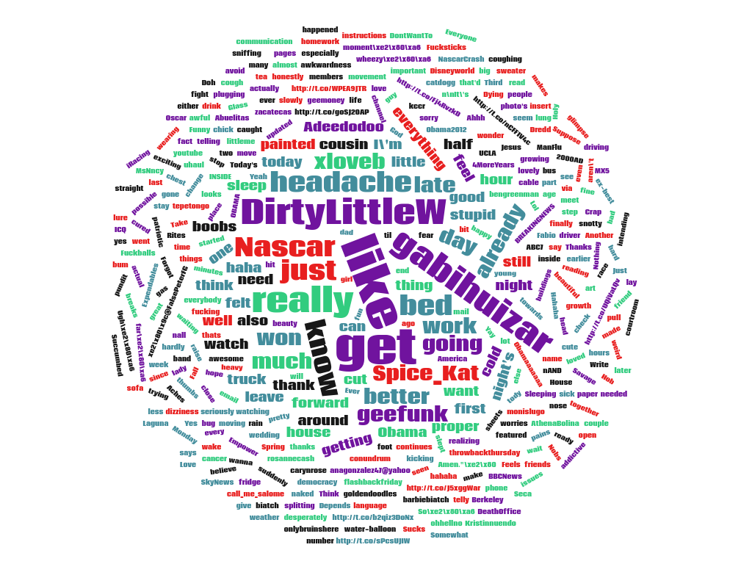
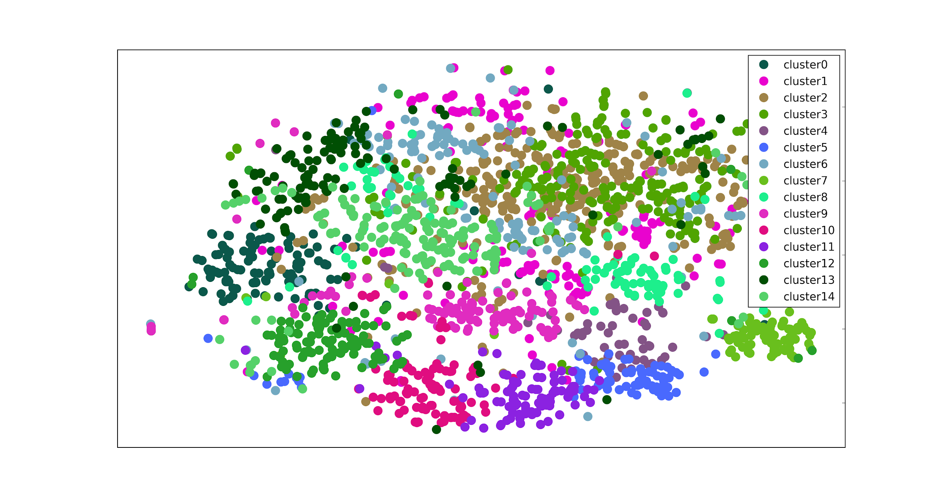
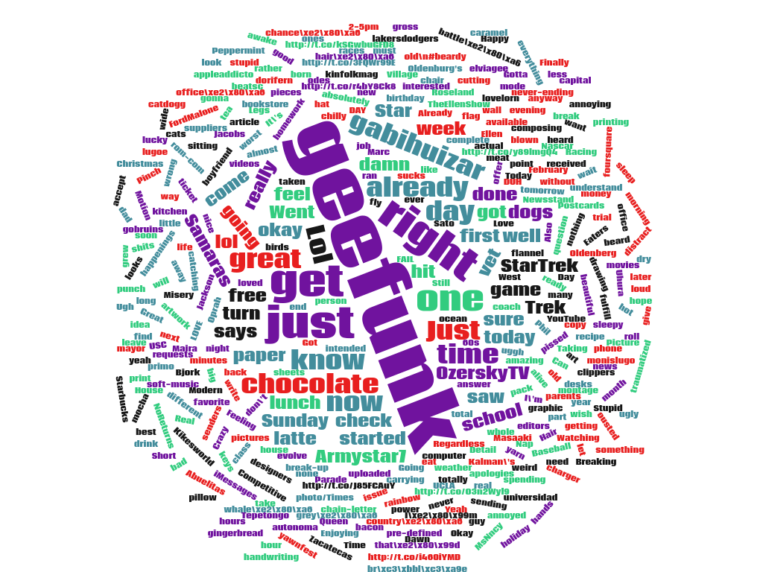
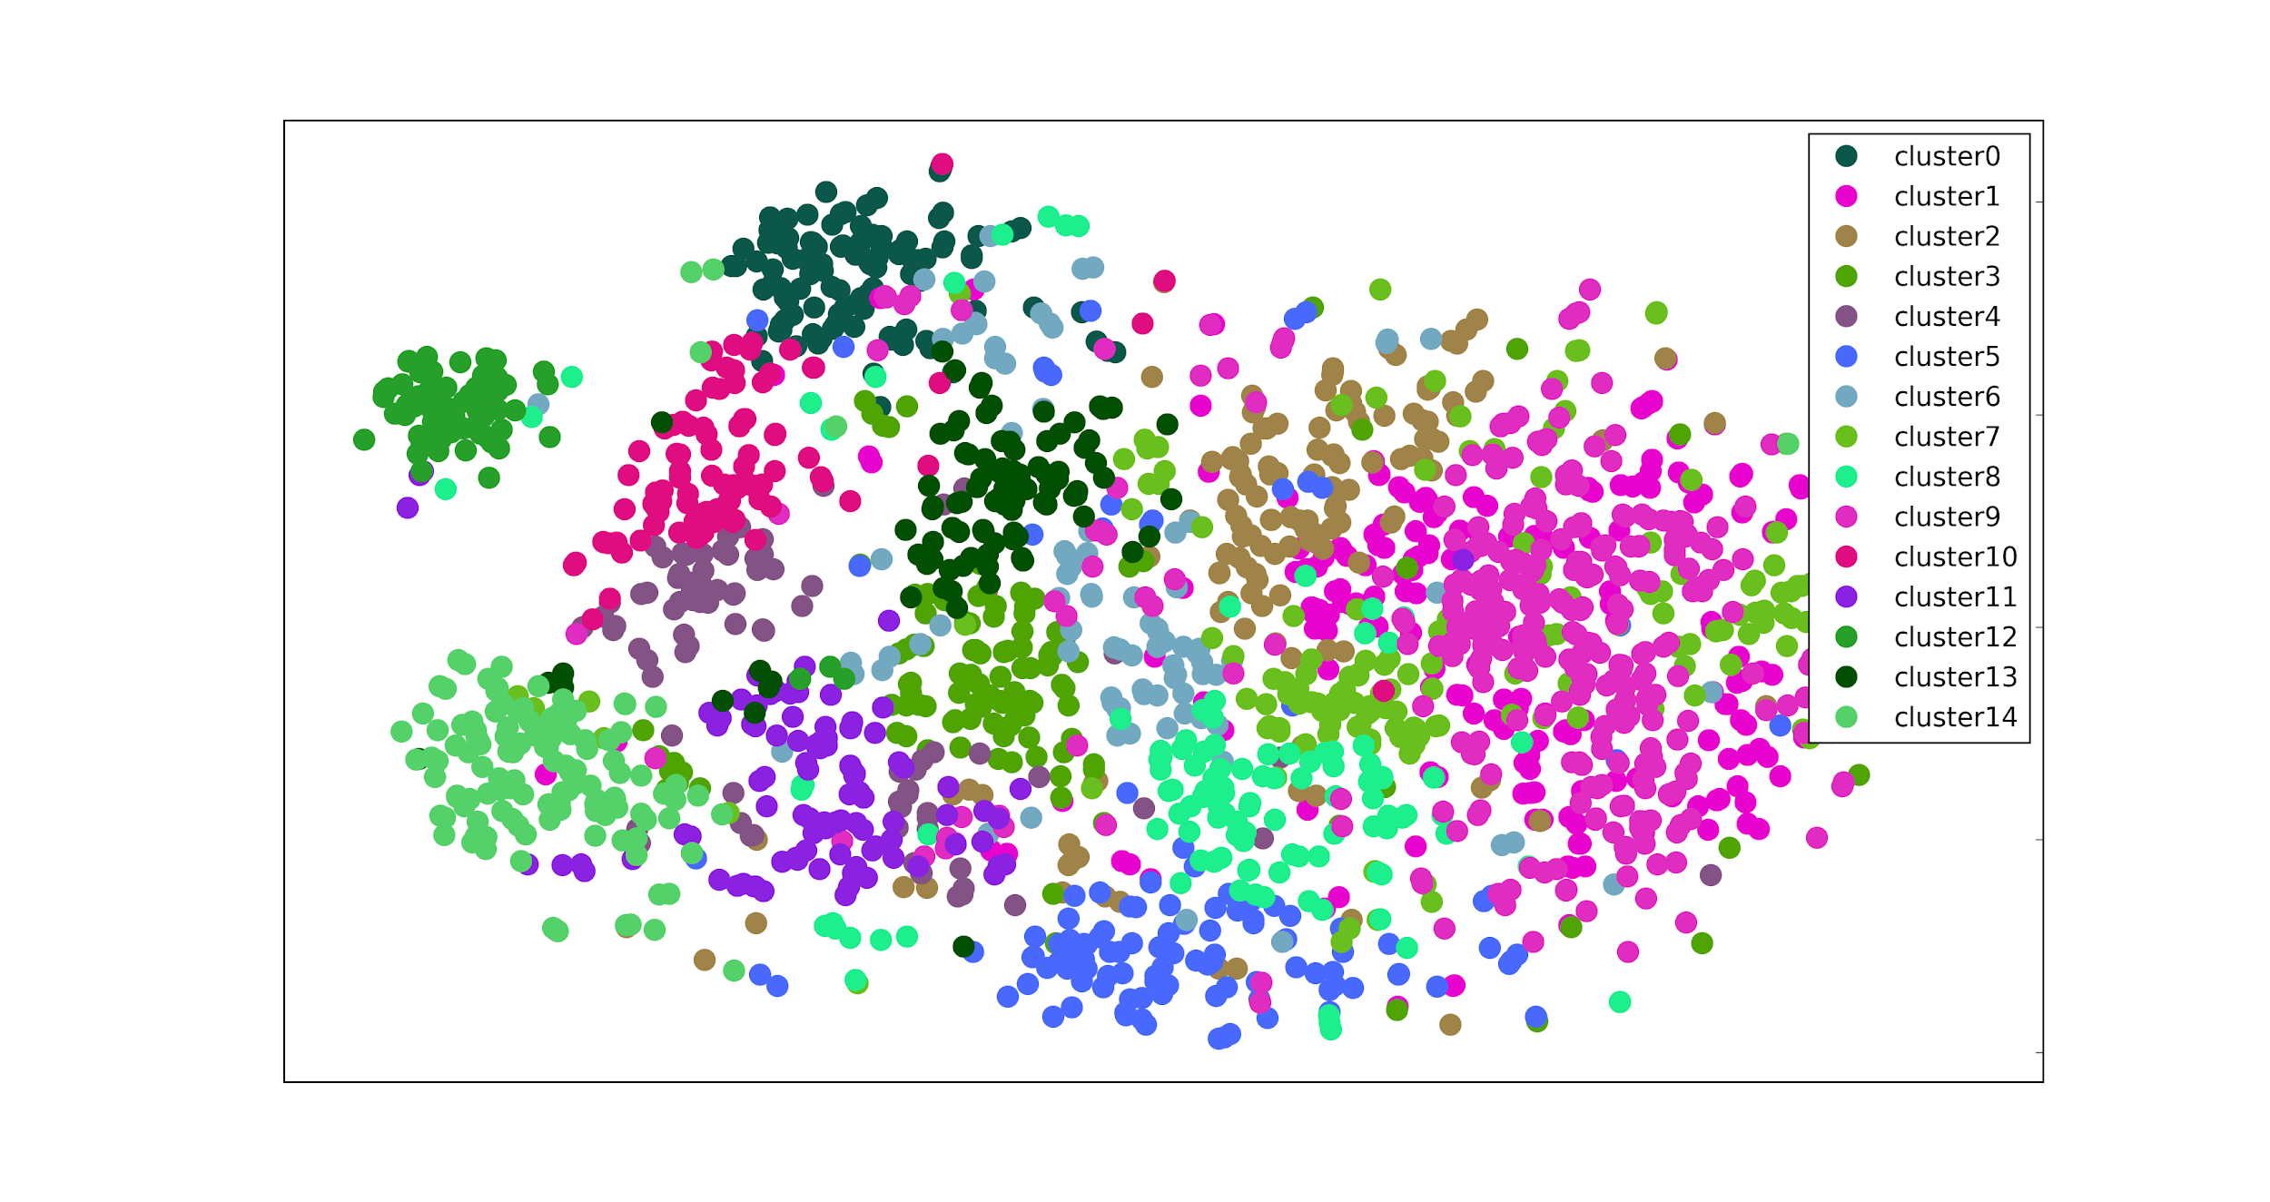
User Embeddings
Overall change in tweet topics over weeks
Week 4
Week 5

Slide 5
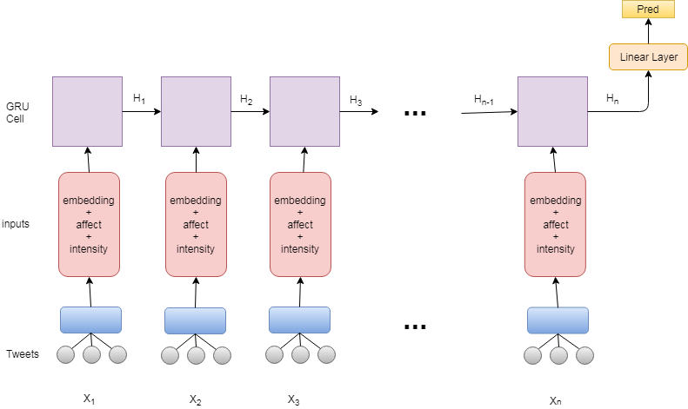
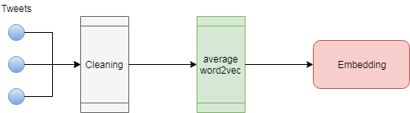
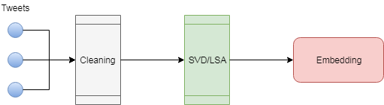
Architecture
Gated Recurrent Unit Network
Predicts Score of User, per Week
Word2Vec Embeddings
SVD based User Embeddings

Slide 6
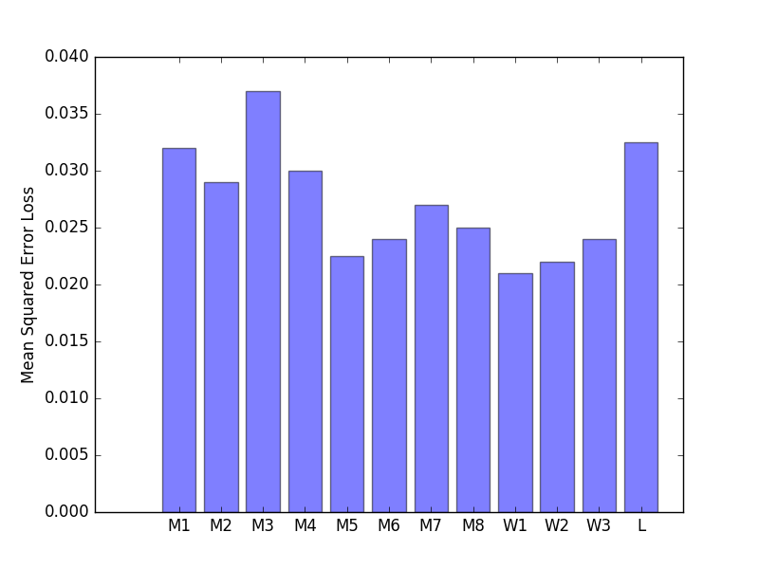
Baselines / Evaluations
Model Details:
GRU-RNN : takes generated weekly embedding per user
Embeddings - average word2vec or temporal user level, affect and intensity scores
Training recurs for each training week
Trained in multiple different window sizes of weeks
Train Data Format:
x1: Week1, Week2, label1: Week3
x1 - all features of weeks in x
label - affect score of week in label
Experiments: 12 Models
Hidden size : 250
Hidden layers : 1
Learning rate : 0.001
Optimizer : Stochastic Gradient Descent
Baseline: Multivariate ridge regression (α = 0.1) with only affect scores and intensity value
M1 - Size(x)=3 epochs=3 SVD=20
M2 - Size(x)=1 epochs=3 SVD=20
M3 - Size(x)=7 epochs=3 SVD=20
M4 - Size(x)=2 epochs=3 SVD=20
M5 - Size(x)=1 epochs=3 SVD=2
M6 - Size(x)=1 epochs=3 SVD=5
M7 - Size(x)=1 epochs=3 SVD=15
M8 - Size(x)=1 epochs=3 SVD=10
W1, W2, W3: Size(x) = 1,2,7 epochs=2 dim=50
L (Baseline) - Size(x)=3

Slide 7
Key Takeaways
Improvements
Adding language features through embeddings improves performance
Our novel way of building user embeddings captures temporal change in the user’s language change in mood
Model performs almost as good as the state-of-the-art word2vec vectors (state-of-the art in many applications) as inputs to GRUs
SVD with components=2 > components=5, in the GRU-RNN. But, the latter performs better in profiling users (clustering)
Challenges
Model does not beat word2vec embeddings. Word2vec is more successful in capturing the semantics and syntax of noisy data
More experiments to be done on other dimensionality reduction techniques to find the best for mood prediction task
More experiments to be done on other forms of (user, week) matrix which captures the temporal information of user data

Slide 8
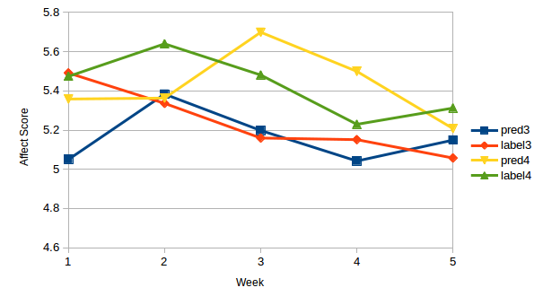
Summary
User embeddings can prove to be helpful in a number of tasks
Even straight forward analysis of language can be better than none
The performance of our model remained stable across weeks
Word2Vec continues to be a versatile way to model language even in time series tasks
Predicting mood for a user continues to be an open question with many improvements to be done
Tweaks and approach for time series user embeddings are still open questions

